Slide 1
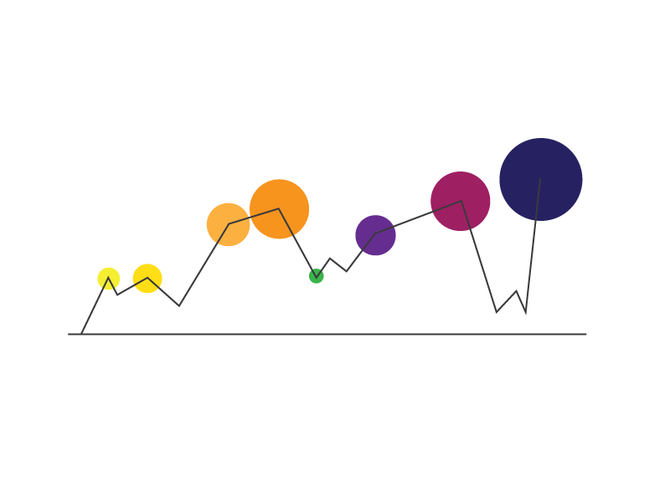
R and Visualization A Match Made in Heaven

Slide 2
Agenda
Today we will know about :
Have a basic understanding of Data Visualization as a field
Create basic and advanced Graphs in R
Change colors or use custom palettes
Customize graphical parameters
Learn basics of Grammar of Graphics
Spatial analysis Visualization

Slide 3
Data Visualization In R
Part 1 : What is Data Visualization ?
Study of the visual representation of data
More than pretty graphs
Gives insights
Helps decision making
Accurate and truthful
Why Data Visualization?
"Lies, damned lies, and statistics" is a phrase describing the persuasive power of numbers, particularly the use
of statistics to bolster weak argument
Cue to Anscombe-Case Study
Source- Anscombe (1973) http://www.sjsu.edu/faculty/gerstman/StatPrimer/anscombe1973.pdf

Slide 4
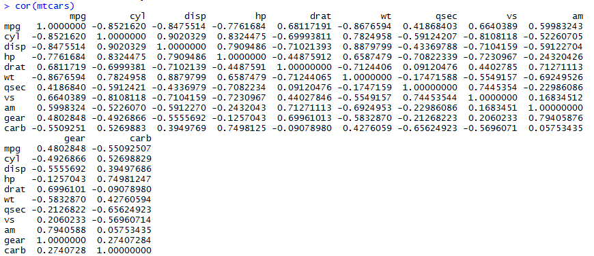
Data Visualization In R
Part 4 : Does This Make Sense?
> cor(mtcars)

Slide 5
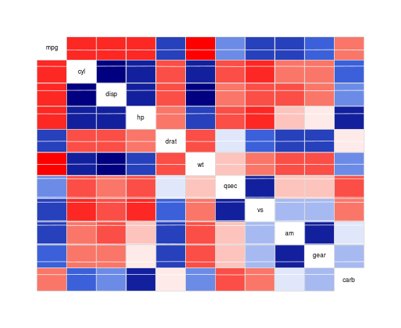
Data Visualization In R
Part 4 : Does This Make Better Sense?
>library(corrgram)
> corrgram(mtcars) RED is negative BLUE is positive
Darker the color, more the correlation

Slide 6
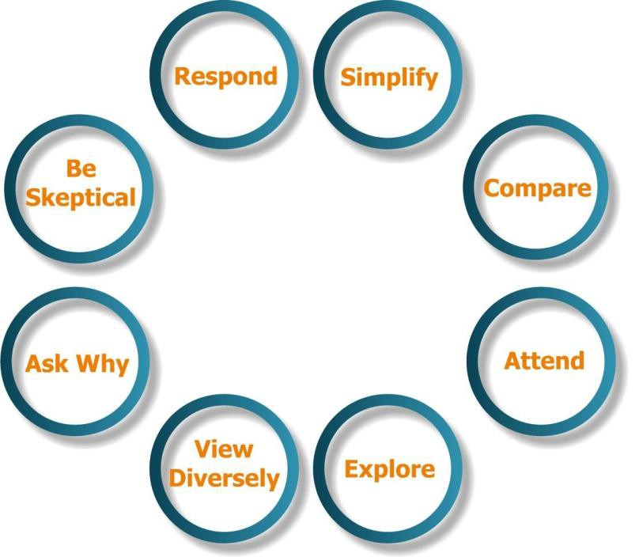
Effective Data Visualization
Part 2 : Stephen Few on Effective Data Visualization
Stephen Few's
8 Core Priniciples
Also - http://www.perceptualedge.com/

Slide 7
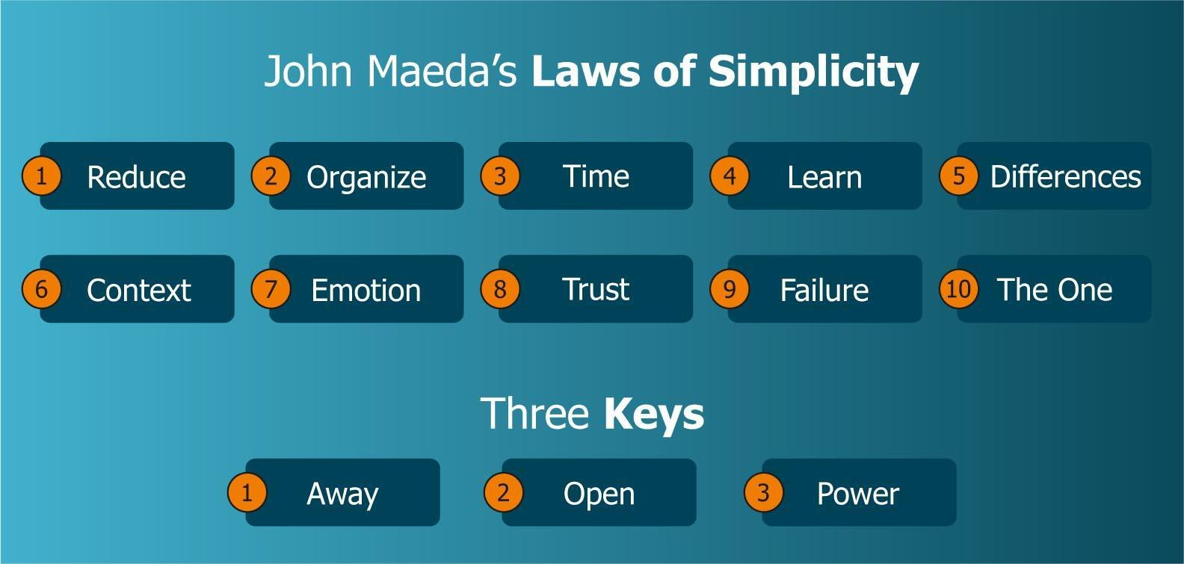
Data Visualization In R
Part 2 : John Maeda on Laws of Simplicity
Also - http://lawsofsimplicity.com/

Slide 8
Grammar of Graphics
Part 2 : Leland Wilkinson/Hadley Wickham on Grammar of Graphics
When creating a plot we start with data
We can create many different types of plots using this same basic specification.
(Bars, lines, and points are all examples of geometric objects)
We can scale the axes
We can statistically transform the data (bins, aggregates)
The concept of Layers
Plot = data 1 + scales and coordinate system 2 + plot annotations 3
1 data plot type
2 Axes and legends
3 background and plot title
See - http://vita.had.co.nz/papers/layered-grammar.pdf

Slide 9
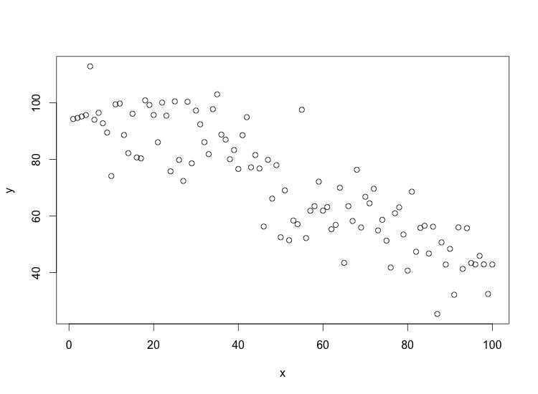
Grammar of Graphics
Part 2 : Leland Wilkinson/Hadley Wickham on Grammar of Graphics
The layered grammar defines the components of a plot as:
A default dataset and set of mappings from variables to aesthetics,
One or more layers, with each layer having one geometric object, one statistical transformation, one position adjustment, and optionally, one dataset and set of aesthetic mappings,
One scale for each aesthetic mapping used,
A coordinate system,
The facet specification

Slide 10
Basic graphs in R
Part 3 : Basic graphs in R (and which one should we use when?)
Pie Chart (never use them)
Scatter Plot (always use them?)
Line Graph (Linear Trend)
Bar Graphs (When are they better than Line graphs?)
Sunflower plot (overplotting)
Rug Plot
Density Plot
Histograms (Give us a good break!)
Box Plots

Slide 11
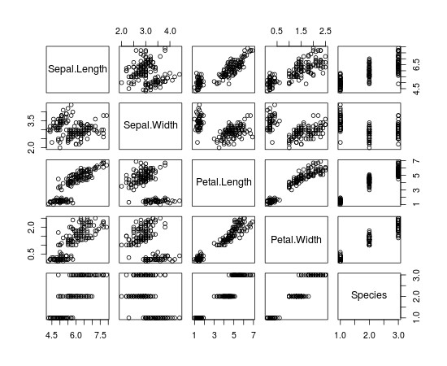
Basic graphs in R
Part 3 : Basic graphs in R
plot(iris)
Plot the entire object
See how variables behave with each other

Slide 12
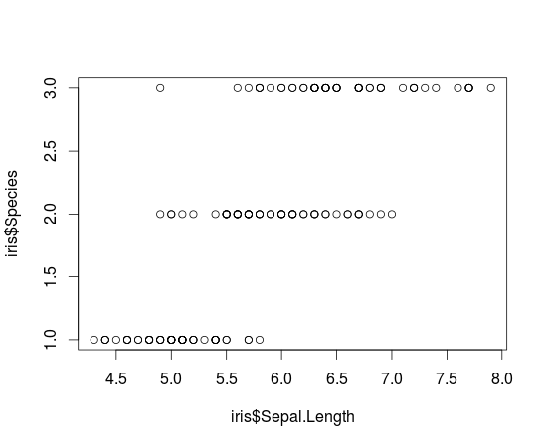
Basic graphs in R
Part 3 Basic graphs in R
Plot(iris$Sepal.Length, iris$Species)
Plot two variables at a time to closely examine relationship

Slide 13
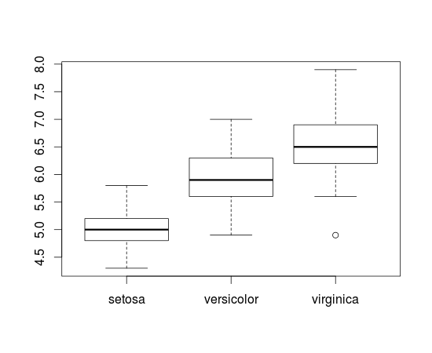
Basic graphs in R
Part 3 Basic graphs in R
plot(iris$Species, iris$Sepal.Length)
Plot two variables at a time
Order is important
Hint- Keep factor variables to X axis Box Plot- Five Numbers! minimum, first quartile, median,
third quartile, maximum.

Slide 14
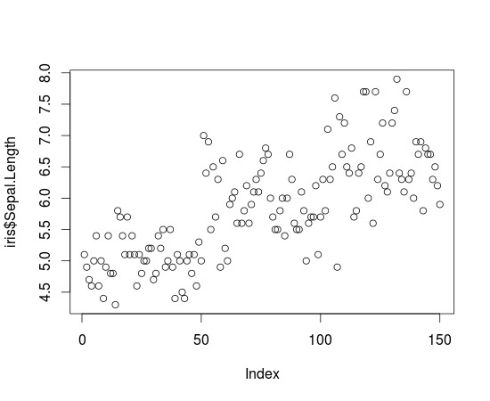
Basic graphs in R
Part 3 : Basic graphs in R
plot(iris$Sepal.Length)
Plot one variable
Scatterplot

Slide 15
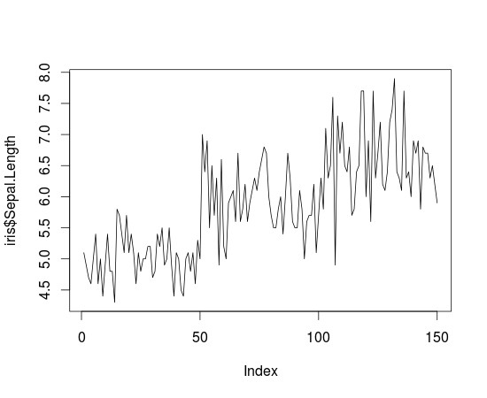
Basic graphs in R
Part 3 : Basic graphs in R
plot(iris$Sepal.Length, type='l')
Plot with type='l'
Used if you need trend (usually with respect to time)
Line graph

Slide 16
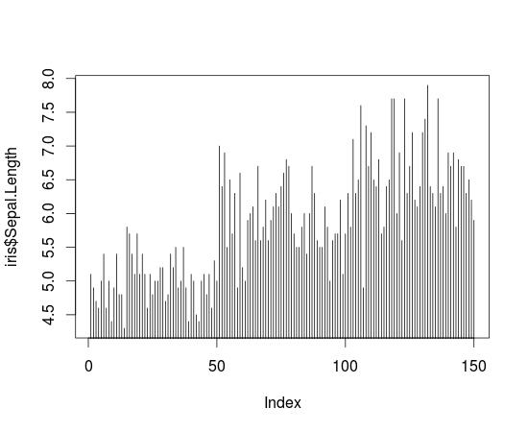
Basic graphs in R
Part 3 : Basic graphs in R
plot(iris$Sepal.Length, type='h')
Graph

Slide 17
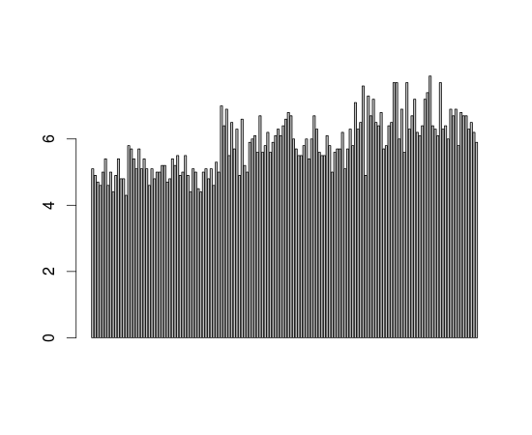
Basic graphs in R
Part 3 Basic graphs in R
barplot(iris$Sepal.Length)
Bar graph

Slide 18
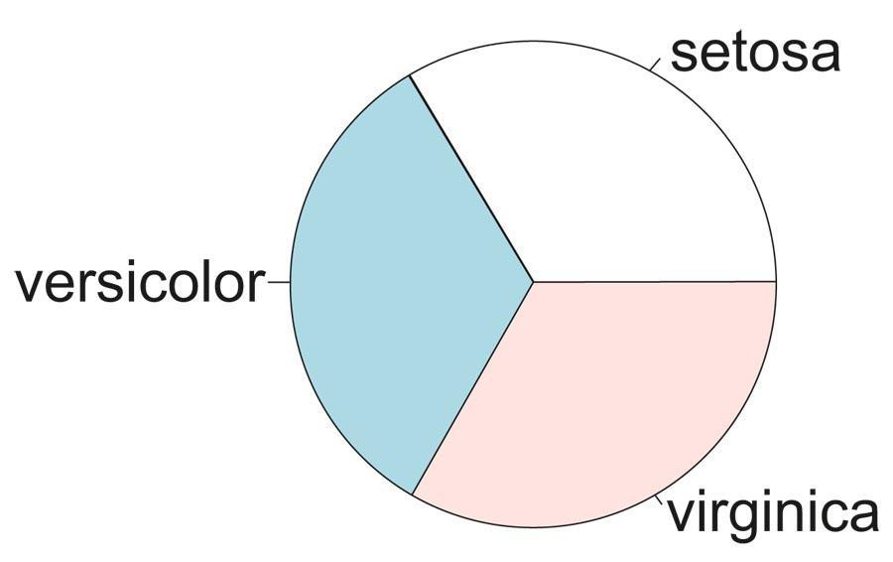
Basic graphs in R
Part 3 Basic graphs in R
pie(table(iris$Species))
Pie graph
NOT Recommended

Slide 19
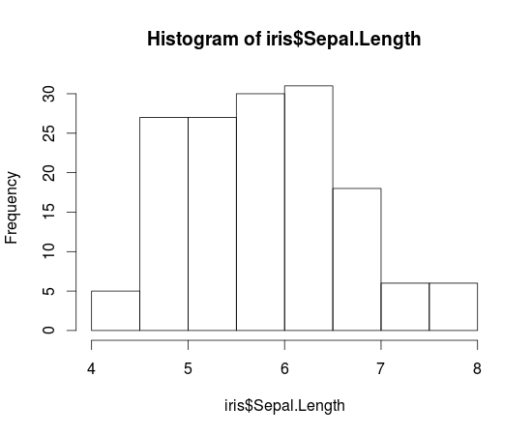
Basic graphs in R
Part 3 : Basic graphs in R
hist(iris$Sepal.Length)

Slide 20
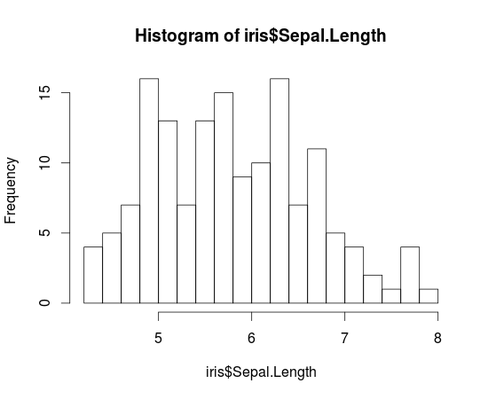
Basic graphs in R
Part 3 : Basic graphs in R
hist(iris$Sepal.Length,breaks=20)

Slide 21
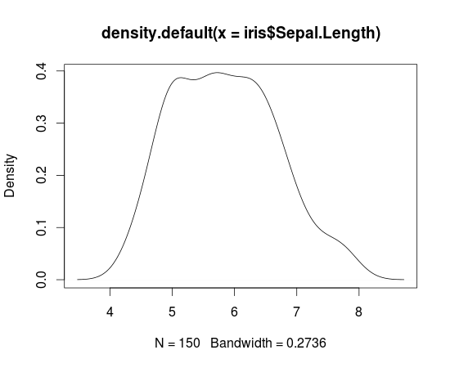
Basic graphs in R
Part 3 : Basic graphs in R
plot(density(iris$Sepal.Length)

Slide 22
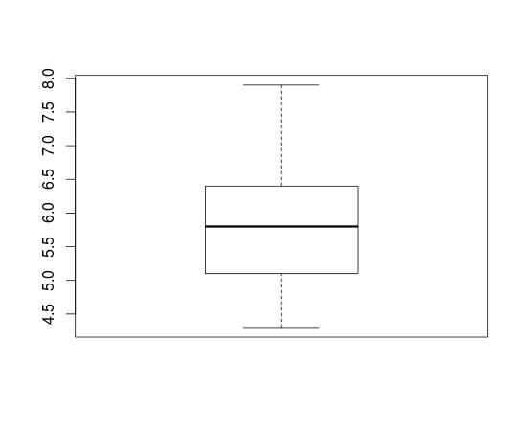
Basic graphs in R
Part 3 : Basic graphs in R
boxplot(iris$Sepal.Length)
Boxplot

Slide 23
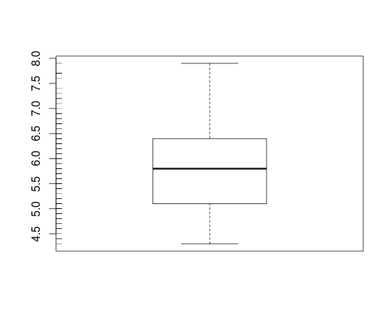
Basic graphs in R
Part 3 : Basic graphs in R
Boxplot with Rug
>boxplot(iris$Sepal.Length)
>rug(iris$Sepal.Length,side=2)
Adds a rug representation (1-d plot) of the data to the plot.

Slide 24
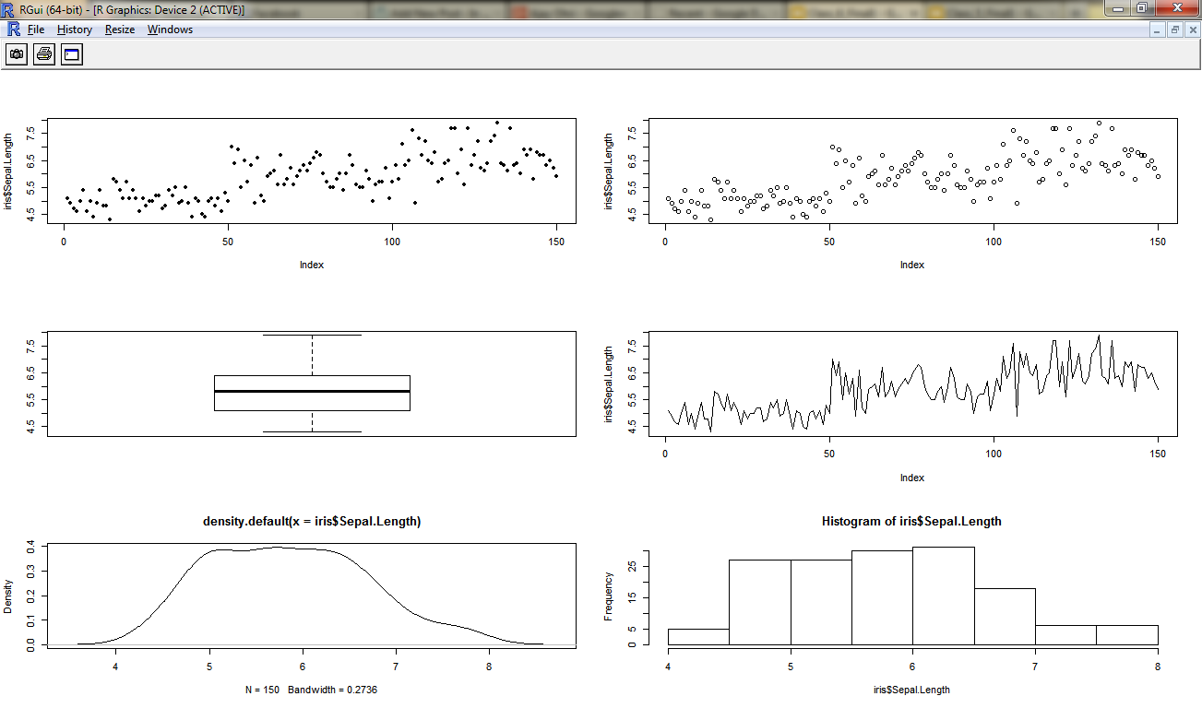
Customizing Graphs
Part 3 Customizing Graphs
Multiple graphs on same screen
par(mfrow=c(3,2))
> sunflowerplot(iris$Sepal.Length)
> plot(iris$Sepal.Length)
> boxplot(iris$Sepal.Length)
> plot(iris$Sepal.Length,type="l")
> plot(density(iris$Sepal.Length))
> hist(iris$Sepal.Length)

Slide 25

Customizing Graphs
Part 3 : Customizing Graphs
Multiple graphs on same screen
par(mfrow=c(3,2))
> sunflowerplot(iris$Sepal.Length)
> plot(iris$Sepal.Length)
> boxplot(iris$Sepal.Length)
> plot(iris$Sepal.Length,type="l")
> plot(density(iris$Sepal.Length))
> hist(iris$Sepal.Length)
???

Slide 26
Customizing Graphs
Part 3 : Customizing Graphs
Multiple graphs on same screen
par(mfrow=c(3,2))
> sunflowerplot(iris$Sepal.Length)
> plot(iris$Sepal.Length)
> boxplot(iris$Sepal.Length)
> plot(iris$Sepal.Length,type="l")
> plot(density(iris$Sepal.Length))
> hist(iris$Sepal.Length)
Over-plotting

Slide 27
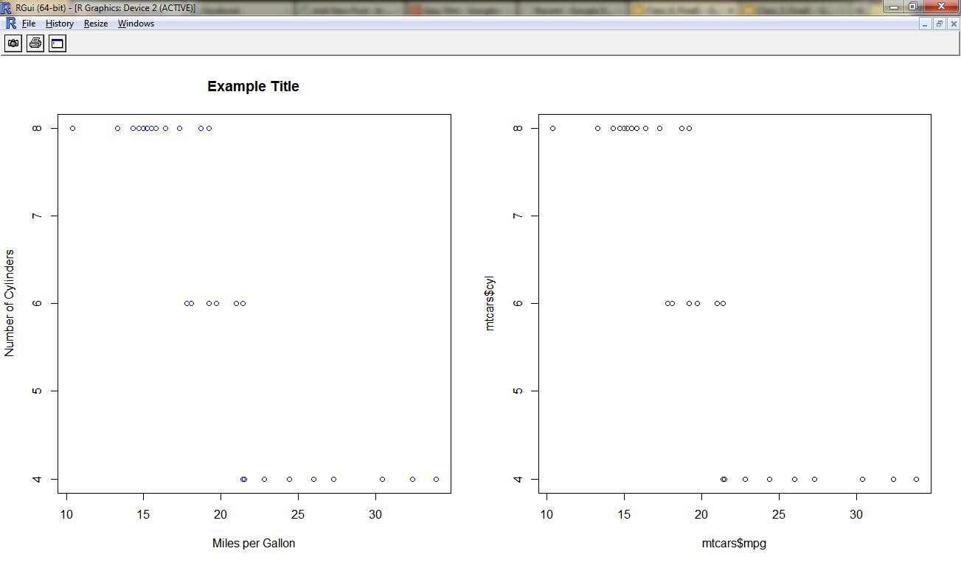
Customizing Graphs
Part 3 : Customizing Graphs
X Axis, Y Axis, Title, Color
par(mfrow=c(1,2))
> plot(mtcars$mpg,mtcars$cyl,main="Example Title",col="blue",xlab="Miles per Gallon", ylab="Number of Cylinders")
> plot(mtcars$mpg,mtcars$cyl)

Slide 28
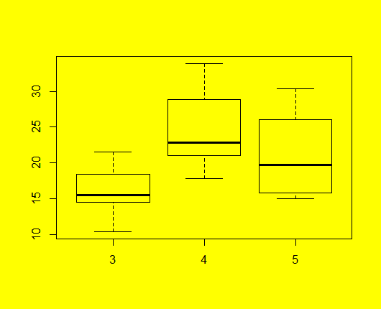
Customizing Graphs
Part 3 : Customizing Graphs
Background
Try a variation of this yourself par(bg="yellow") boxplot(mtcars$mpg~mtcars$gear)

Slide 29
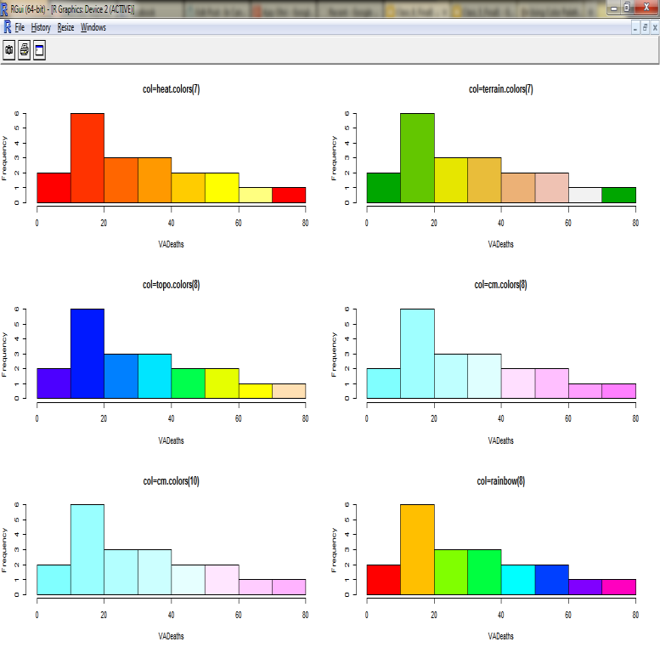
Customizing Graphs
Part 3 : Customizing Graphs
Use Color Palettes
> par(mfrow=c(3,2))
> hist(VADeaths,col=heat.colors(7),main="col=heat.colors(7)")
> hist(VADeaths,col=terrain.colors(7),main="col=terrain.colors(7)")
> hist(VADeaths,col=topo.colors(8),main="col=topo.colors(8)")
> hist(VADeaths,col=cm.colors(8),main="col=cm.colors(8)")
> hist(VADeaths,col=cm.colors(10),main="col=cm.colors(10)")
> hist(VADeaths,col=rainbow(8),main="col=rainbow(8)")
source- http://decisionstats.com/2011/04/21/using-color-palettes-in-r/

Slide 30
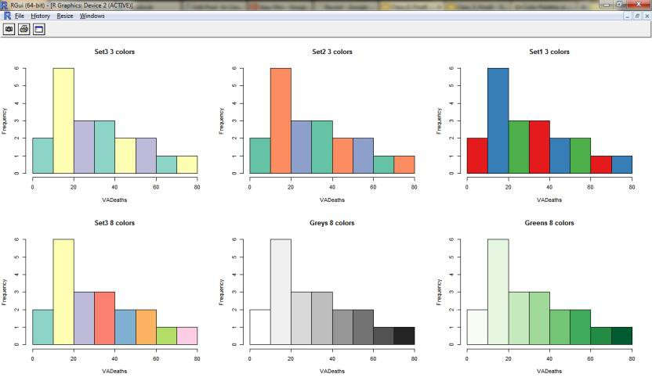
Customizing Graphs
Part 3 : Customizing Graphs
Use Color Palettes in RColorBrewer
> library(RColorBrewer)
> par(mfrow=c(2,3))
> hist(VADeaths,col=brewer.pal(3,"Set3"),main="Set3 3 colors")
> hist(VADeaths,col=brewer.pal(3,"Set2"),main="Set2 3 colors")
> hist(VADeaths,col=brewer.pal(3,"Set1"),main="Set1 3 colors")
> hist(VADeaths,col=brewer.pal(8,"Set3"),main="Set3 8 colors")
> hist(VADeaths,col=brewer.pal(8,"Greys"),main="Greys 8 colors")
> hist(VADeaths,col=brewer.pal(8,"Greens"),main="Greens 8 colors")
source- http://decisionstats.com/2012/04/08/color-palettes-in-r-using-rcolorbrewer-rstats/

Slide 31
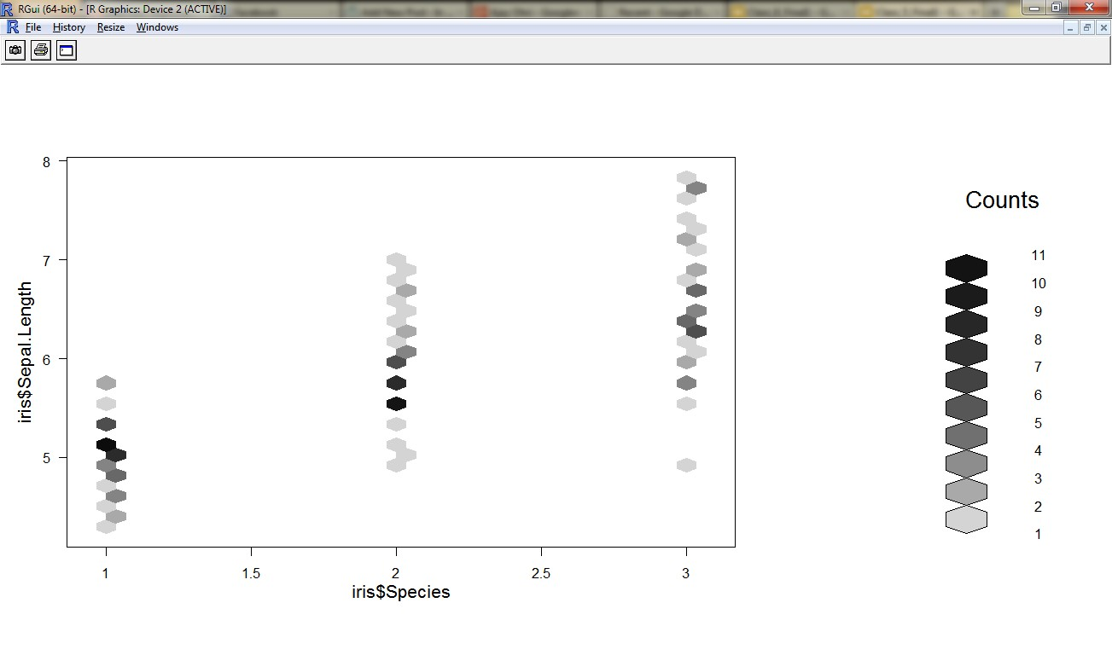
Advanced Graphs
Part 4 Advanced Graphs
Hexbin for over plotting
(many data points at same) library(hexbin)
plot(hexbin(iris$Species,iris$Sepal.Length))

Slide 32
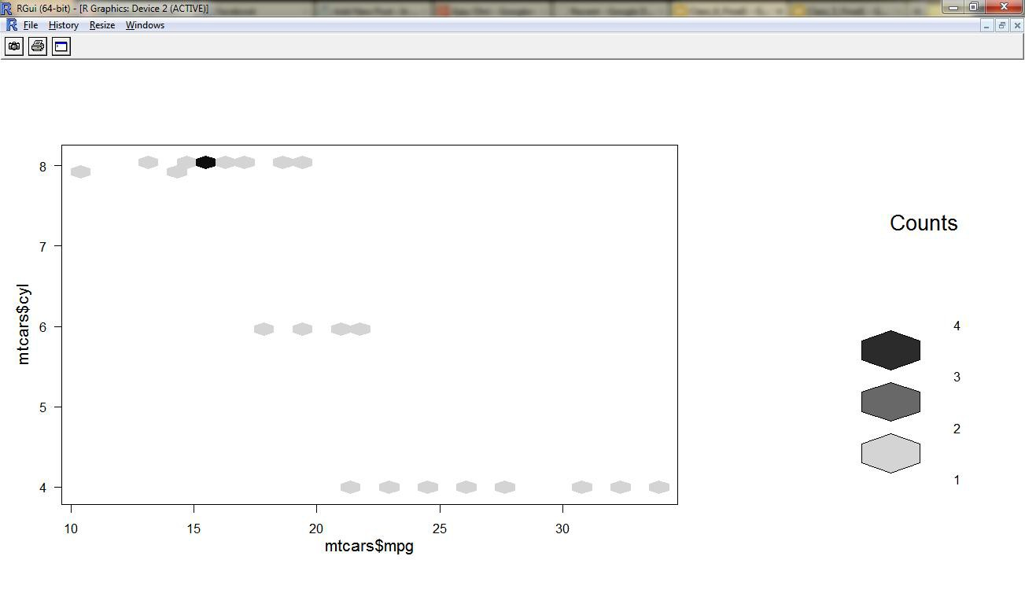
Advanced Graphs
Part 4 Advanced Graphs
Hexbin for over plotting
(many data points at same) library(hexbin)
plot(hexbin(mtcars$mpg,mtcars$cyl))

Slide 33
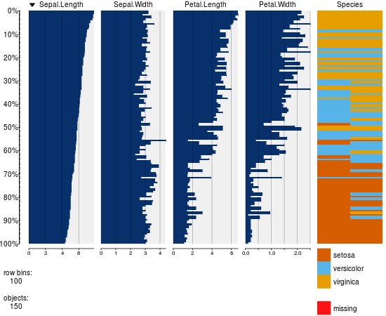
Advanced Graphs
Part 4 : Advanced Graphs
Tabplot for visual summary of a dataset
library(tabplot)
tableplot(iris)

Slide 34
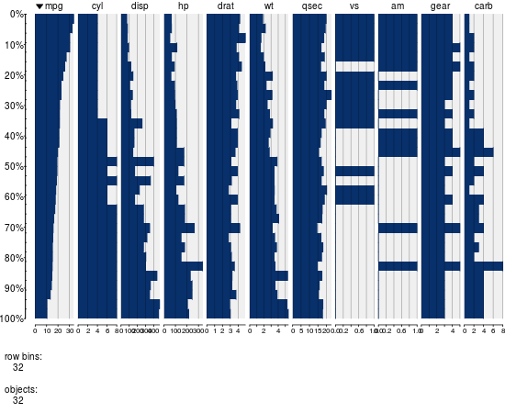
Advanced Graphs
Part 4 : Advanced Graphs
Tabplot for visual summary of a dataset
library(tabplot)
tableplot(mtcars)

Slide 35
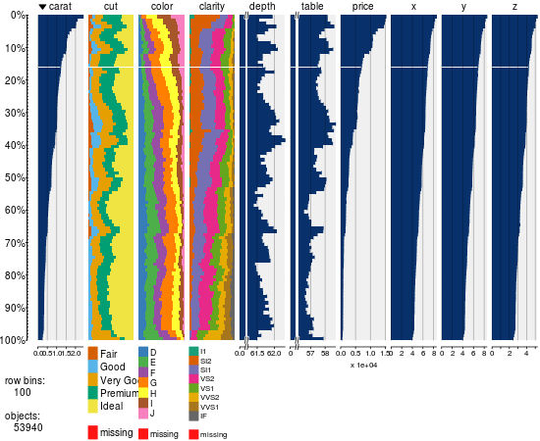
Advanced Graphs
Part 4 Advanced Graphs
Tabplot for visual summary of a dataset
Can summarize a lot of data relatively fast
library(tabplot) library(ggplot) tableplot(diamonds)

Slide 36
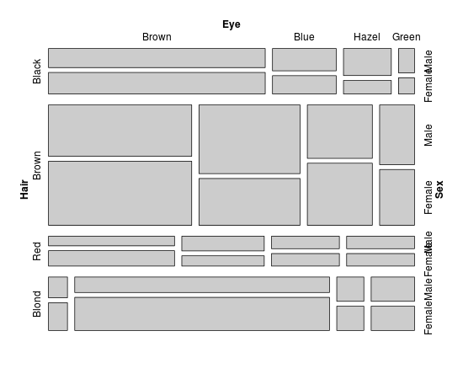
Advanced Graphs
Part 4 : Advanced Graphs
vcd for categorical data
mosaic
library(vcd) mosaic(HairEyeColor)

Slide 37
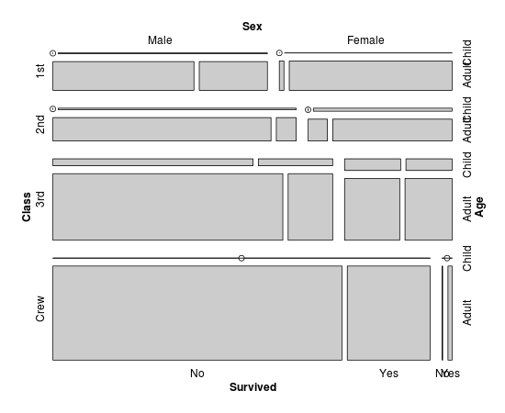
Advanced Graphs
Part 4 : Advanced Graphs
vcd for categorical data
mosaic
library(vcd) mosaic(Titanic)

Slide 38
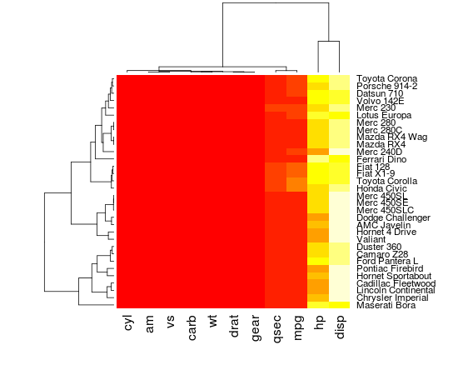
Advanced Graphs
Part 4 : Lots of Graphs in R
heatmap(as.matrix(mtcars))

Slide 39
Spatial Analysis
Part 5 : Spatial Analysis
Base R includes many functions that can be used for reading, vizualising, and analysing spatial data.
The focus is on "geographical" spatial data, where observations can be identified with geographical locations
Sources –
http://spatial.ly/r/
http://cran.r-project.org/web/views/Spatial.html
http://rspatial.r-forge.r-project.org/

Slide 40
Spatial Analysis
Part 5 : Spatial Analysis : Example
library(sp)
library(maptools)
nc <- readShapePoly(system.file("shapes/sids.shp", package="maptools")[1],
proj4string=CRS("+proj=longlat +datum=NAD27"))
names(nc)
# create two dummy factor variables, with equal labels:
set.seed(31)
nc$f = factor(sample(1:5,100,replace=T),labels=letters[1:5])
nc$g = factor(sample(1:5,100,replace=T),labels=letters[1:5])
library(RColorBrewer)
## Two (dummy) factor variables shown with qualitative colour ramp; degrees in axes
spplot(nc, c("f","g"), col.regions=brewer.pal(5, "Set3"), scales=list(draw = TRUE))

Slide 41
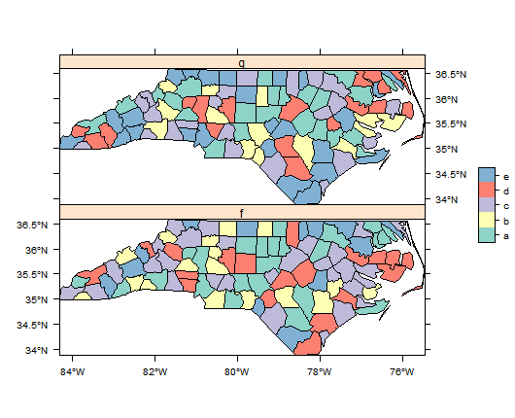
Spatial Analysis
Part 5 : Spatial Analysis : Example
library(sp) library(maptools)
nc <- readShapePoly(system.file("shapes/sids.shp", package="maptools")[1], proj4string=CRS("+proj=longlat +datum=NAD27"))
names(nc)
# create two dummy factor variables, with equal labels: set.seed(31)
nc$f = factor(sample(1:5,100,replace=T),labels=letters[1:5]) nc$g = factor(sample(1:5,100,replace=T),labels=letters[1:5]) library(RColorBrewer)
## Two (dummy) factor variables shown with qualitative colour ramp; degrees in axesspplot(nc, c("f","g"), col.regions=brewer.pal(5, "Set3"), scales=list(draw = TRUE))

Slide 42
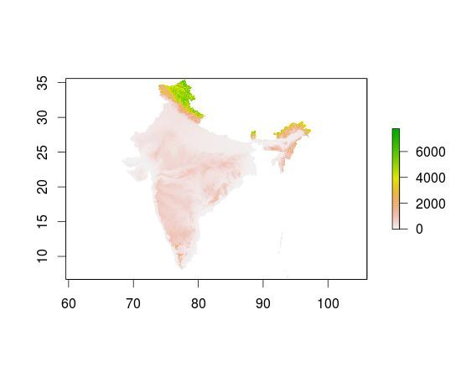
Spatial Analysis
Part 5 : Spatial Analysis : Example
library(raster)
alt <- getData('alt', country = "IND")
plot(alt)

Slide 43
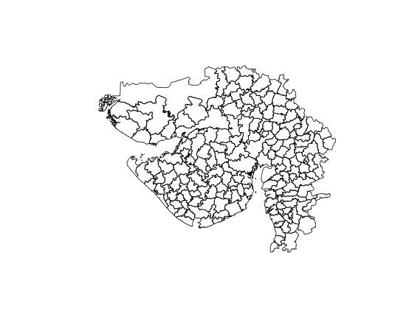
Spatial Analysis
Part 5 : Spatial Analysis : Example
library(raster)
gadm<- getData('GADM', country = "IND", level=3)
head(gadm)
table(gadm$NAME_1) gadm_GUJ=subset(gadm,gadm$NAME_1=="Gujarat")

Slide 44
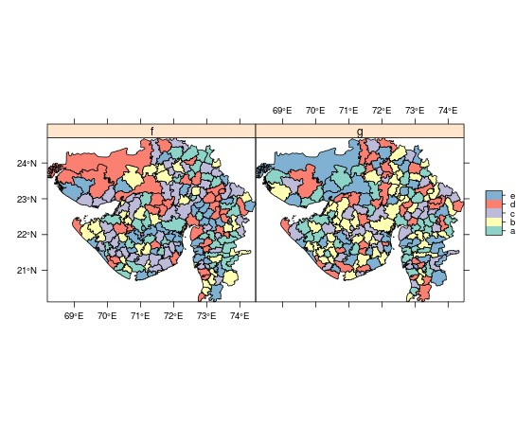
Spatial Analysis
Part 5 : Spatial Analysis : Example
library(raster)
gadm<- getData('GADM', country = "IND", level=3) head(gadm)
table(gadm$NAME_1)
gadm_GUJ=subset(gadm,gadm$NAME_1=="Gujarat")

Slide 45
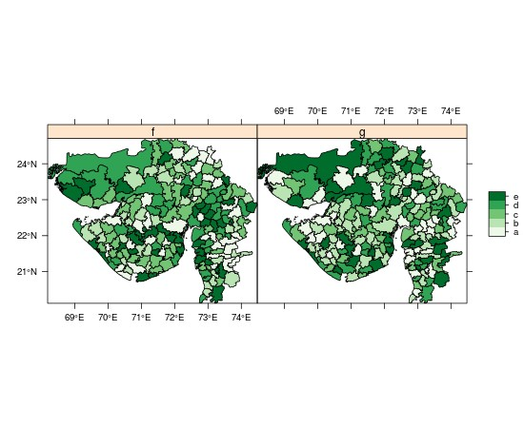
Spatial Analysis
Part 5 : Spatial Analysis : Example
library(raster)
gadm<- getData('GADM', country = "IND", level=3) head(gadm)
table(gadm$NAME_1)
gadm_GUJ=subset(gadm,gadm$NAME_1=="Gujarat")

Slide 46
Survey

